Slide 1
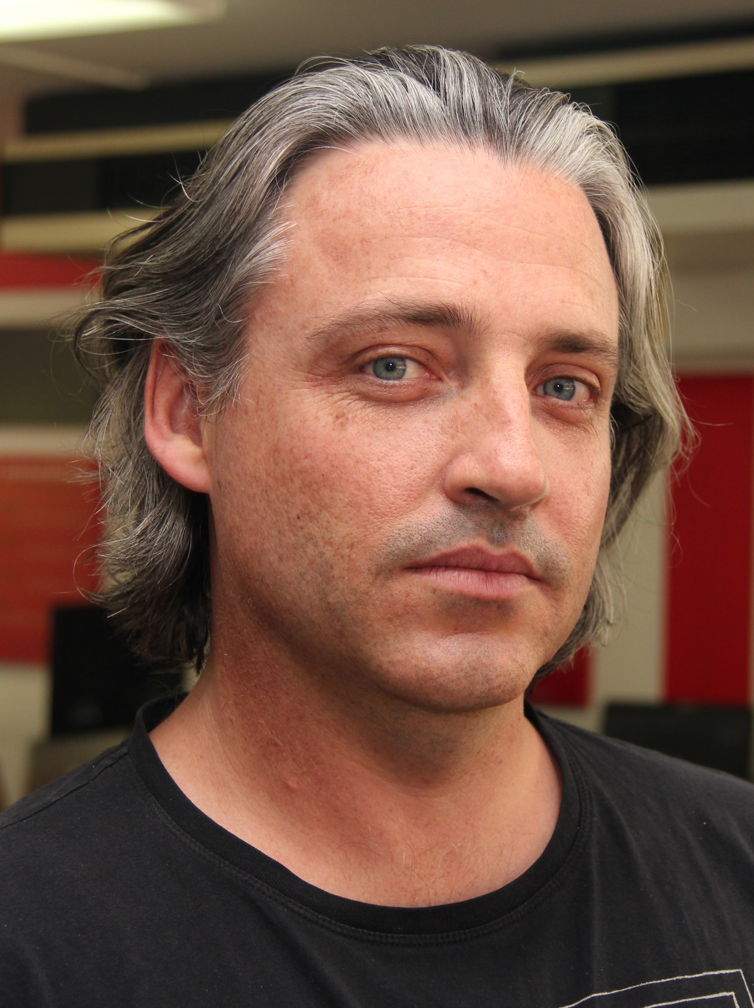
Adam Stephensen
http://adamstephensen.com
@AdamStephensen
Solution Architect at SSW
Building Awesome Teams and Software
Focus on Enterprise Web and Development Best Practices
Principal Mentor @ FireBootCamp
Microsoft Australia Partner Award for Learning

Slide 2

Duncan Hunter
http://duncanhunter.com.au
@DuncHunter
Software Architect at SSW
Angular/TypeScript focus
Rock climber
Notes:
HI my name is Duncan Hunter and I am a Software Architect at SSW.
I spend most of my time at work building out awesome enterprise applications with Angular 1 and Typescript or upskilling teams to use this powerful duo.

Slide 3

What is new in Angular2
@DuncHunter @AdamStephensen
Notes:
I’ve just finished my first application using Visual Studio 2015, MVC 6 and AngularJs
I’m so excited to be be building enterprise web apps, leveraging all the front end best practices developed by the javascript community, using my C#, MVC and WebAPI skills for the backend and doing it all with the productivity of visual studio, .

Slide 4






A brief history of frontend development
1995 - Introduction to JavaScript
1997 - ECMA Script
2002 - XMLHttpRequest (XHR)
2004 - Google Maps - AJAX
2006 - JQuery
2008 - Chrome browser and V8 Engine – The web gets faster
2009 - Nodejs
2010 - Knockout JS
2011 - Angular JS by Google
2015-16 – Angular 2.0 and ES6
Notes:
Lets start with a walk down memory lane

Slide 5
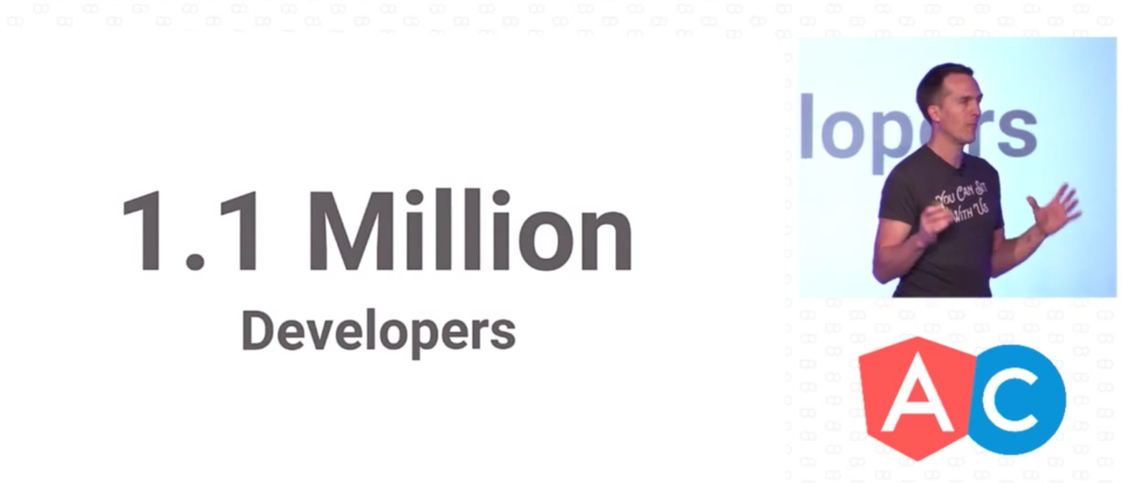
Notes:
Brad green at this weeks conference on google

Slide 6
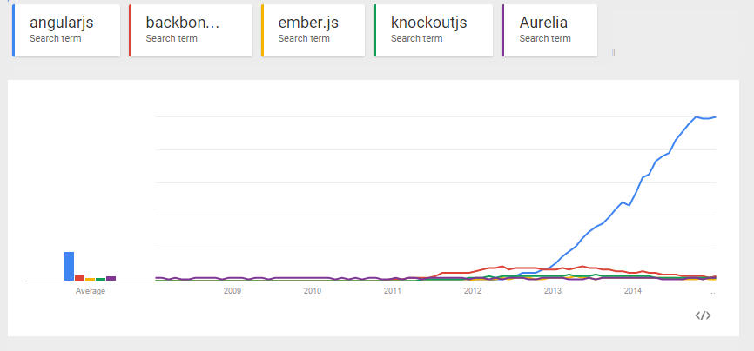
Popularity
Notes:
Dominate the frontend space
Google use it and so many companies have vested interest it is not going any where

Slide 7
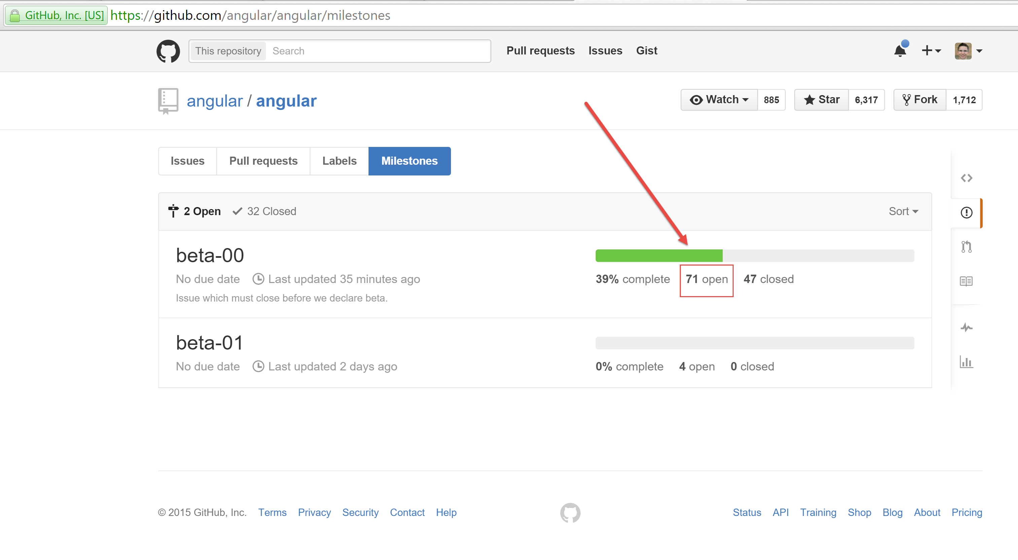

Slide 8
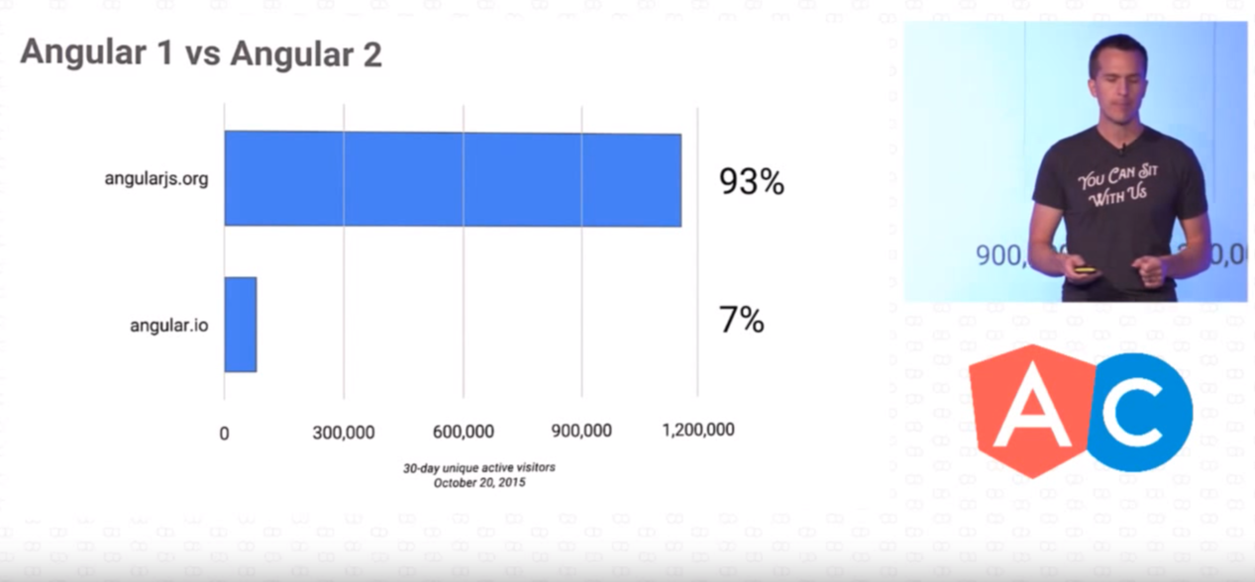

Slide 9

Notes:
Angular2 going to be a big learning curve for most us like Angular1 was
but ultimately I think it will be easier framework to use once we get our heads around the changes

Slide 10
Angular 2.0 improvements
Better performance
Easier to use
Use new web standards

Slide 11
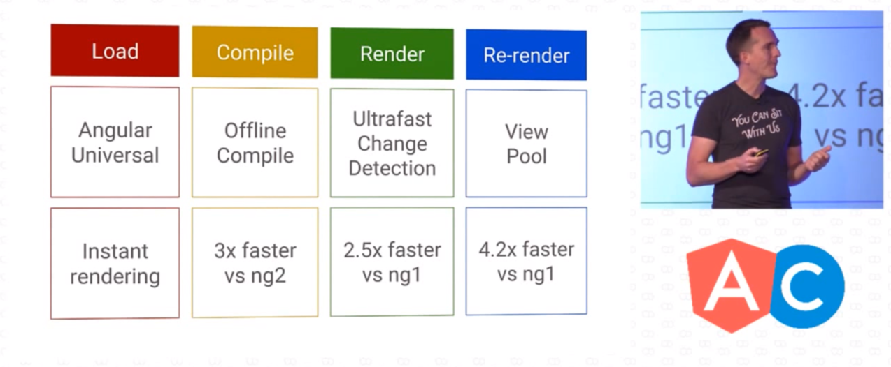
Performance

Slide 12
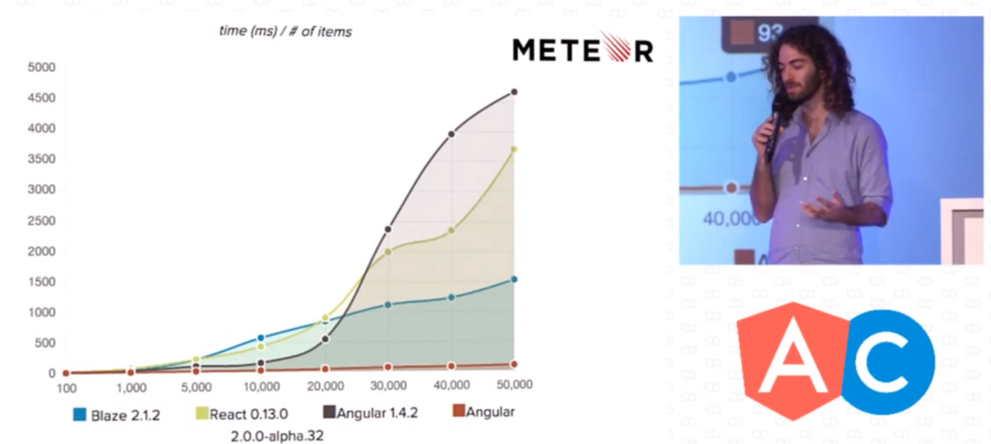
Performance

Slide 13
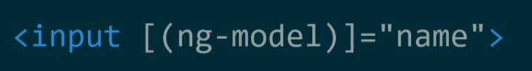
No Two-Way data-binding and a lot of new syntax
Join the Conversation #AngularSuperPowersTour @AdamStephensen @DuncHunter
Notes:
Better Performance by taking away the digest cycle and having a more explicit data flow
All new syntax to simply uses a combination of property and event binding.

Slide 14
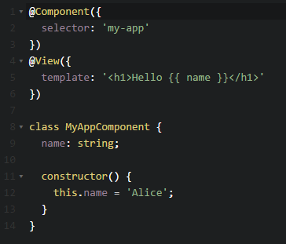

TypeScript will be the default language
Notes:
Angular2 is written in typescript
TypeScript is a types super set ES6 or javascript 2015 maintained by microsoft and it brings some major benefits.
You will have the option to use ES6 or TS or even ES5 but it is a huge change to the JS language
TS will allow for better tooling including code completion and compile time checking to name a couple of things. Crucial to the new decorator syntax.
If you use TS or ES6 you will need to transpile down to ES5.
I have been using TypeScript with Angular1 for over a year in production and it can be a steep learning curve but once you get over that it is rare I meet some one who want to go back.

Slide 15
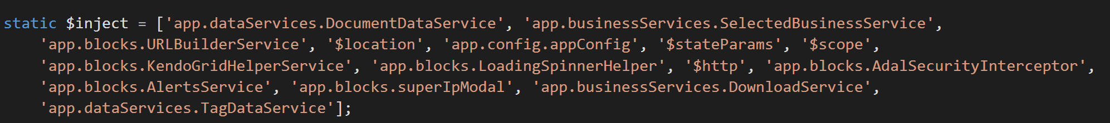
Improved Dependency Injection
Join the Conversation #AngularSuperPowersTour @AdamStephensen @DuncHunter
Notes:
Angular2 is written in typescript
TypeScript is a types super set ES6 or javascript 2015 maintained by microsoft and it brings some major benefits.
You will have the option to use ES6 or TS or even ES5 but it is a huge change to the JS language
TS will allow for better tooling including code completion and compile time checking to name a couple of things. Crucial to the new decorator syntax.
If you use TS or ES6 you will need to transpile down to ES5.
I have been using TypeScript with Angular1 for over a year in production and it can be a steep learning curve but once you get over that it is rare I meet some one who want to go back.

Slide 16
No controllers we now have components
Notes:
The core team dropped controllers but added components and kept the directives.
New component model you will have a component a view and ES6 classes
This follows along more closely with the emerging web component standards.

Slide 17
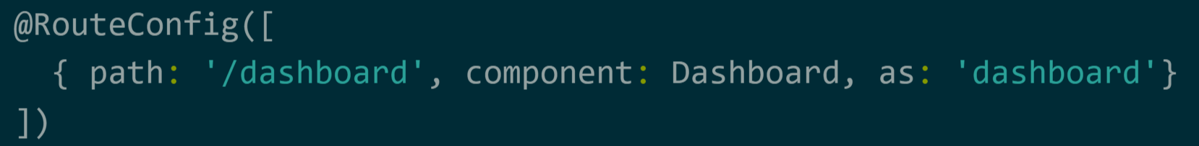

New component router
Notes:
I'd like to consider the new Angular router acomponent router, where components are fundamental building blocks of the modern web.
It will feel similar but at the same time will have many new parts that build on top of the lessons learnt in Angular 1

Slide 18
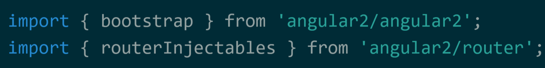


Angular 2 will use ES6 modules
Notes:
Angular 1 there's no way to load them asynchronously, without hacky solutions.
Well, Angular2 uses the ES6 modules.
This allows creating bundles with the modules, which are required during the initial page load and loading all others on demand, asynchronously.
Which is awesome
Opens up room for using tools like JSPM and WebPack to manage our build process in more sophisticated and simpler ways.

Slide 19
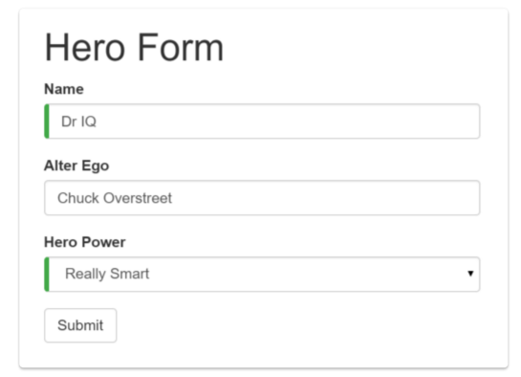
New form

Slide 20

New upgrade pathway

Slide 21
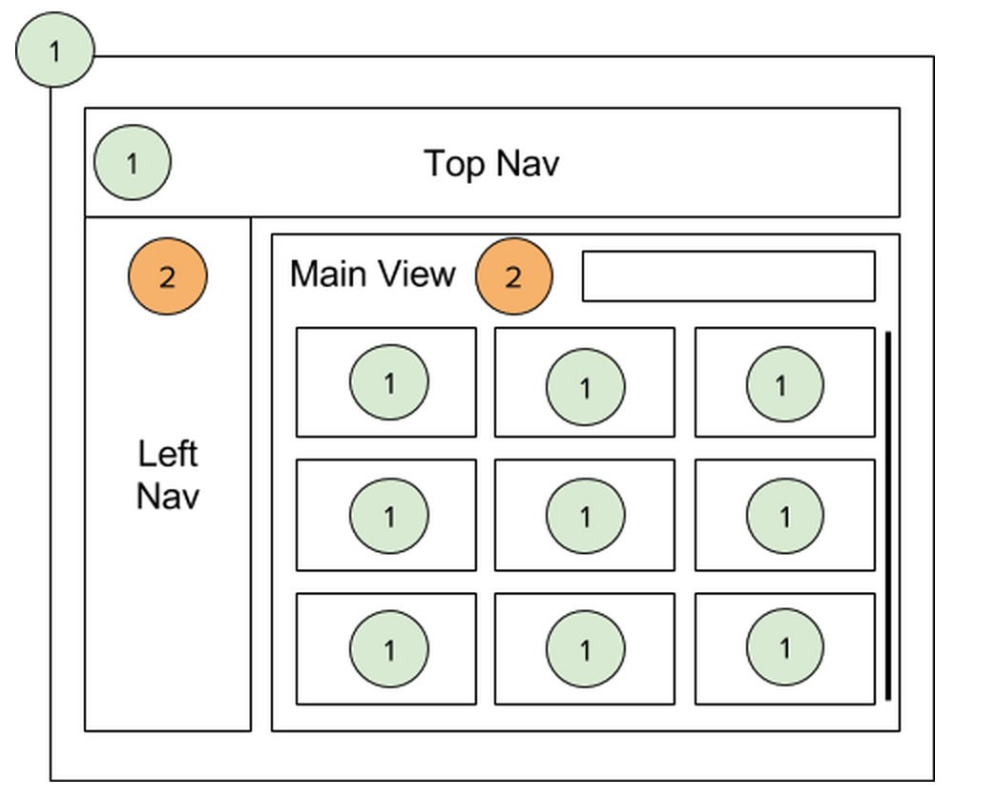
Angular 1 and 2 in the same app!

Slide 22
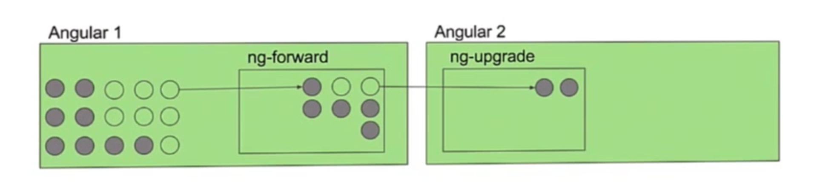
ng-forward and ng-upgrade

Slide 23

New server rendering

Slide 24

Angular 2 will have observables using rx.js
Join the Conversation #AngularSuperPowersTour @AdamStephensen @DuncHunter
Notes:
Angular 1 there's no way to load them asynchronously, without hacky solutions.
Well, Angular2 uses the ES6 modules.
This allows creating bundles with the modules, which are required during the initial page load and loading all others on demand, asynchronously.
Which is awesome
Opens up room for using tools like JSPM and WebPack to manage our build process in more sophisticated and simpler ways.

Slide 25
New filters called pipes
Angular pipes, the simple display-value transformations that we can declare in our HTML!

Slide 26
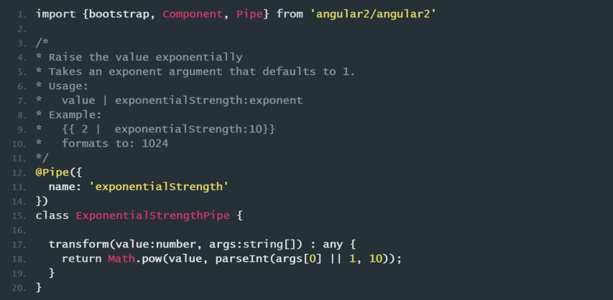
New filters called pipes

Slide 27
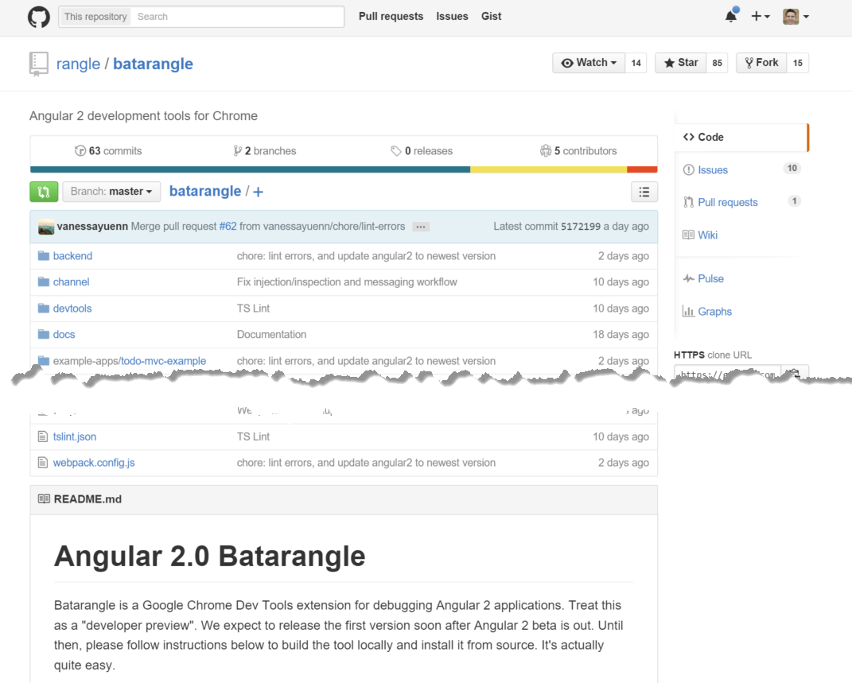

Slide 28
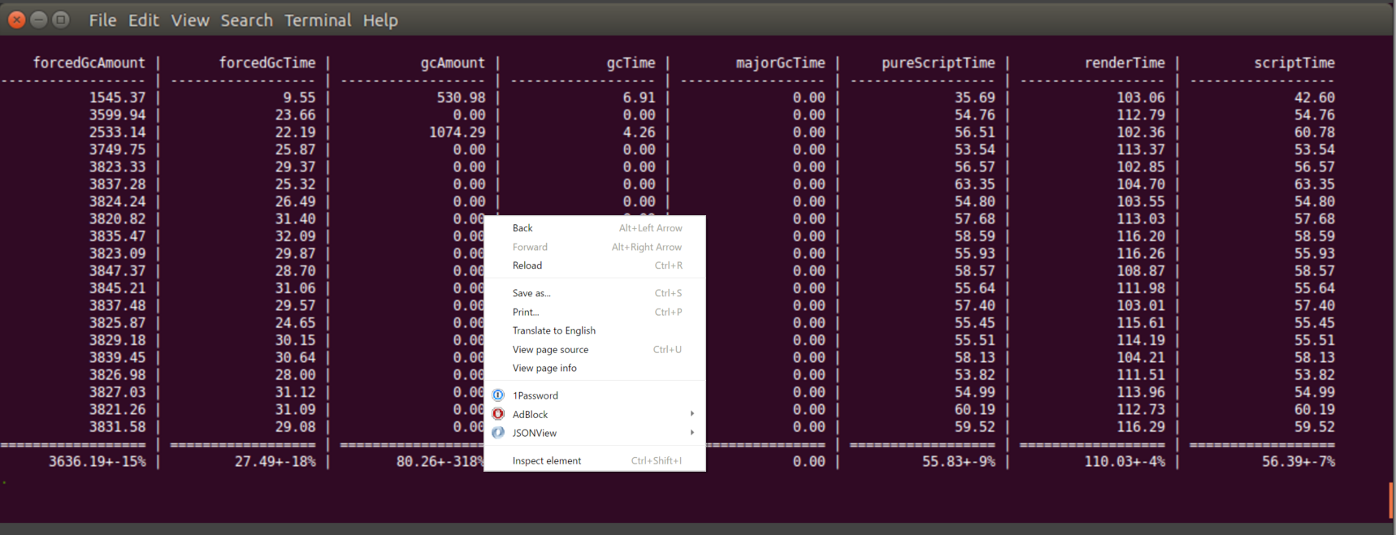
Benchpress

Slide 29
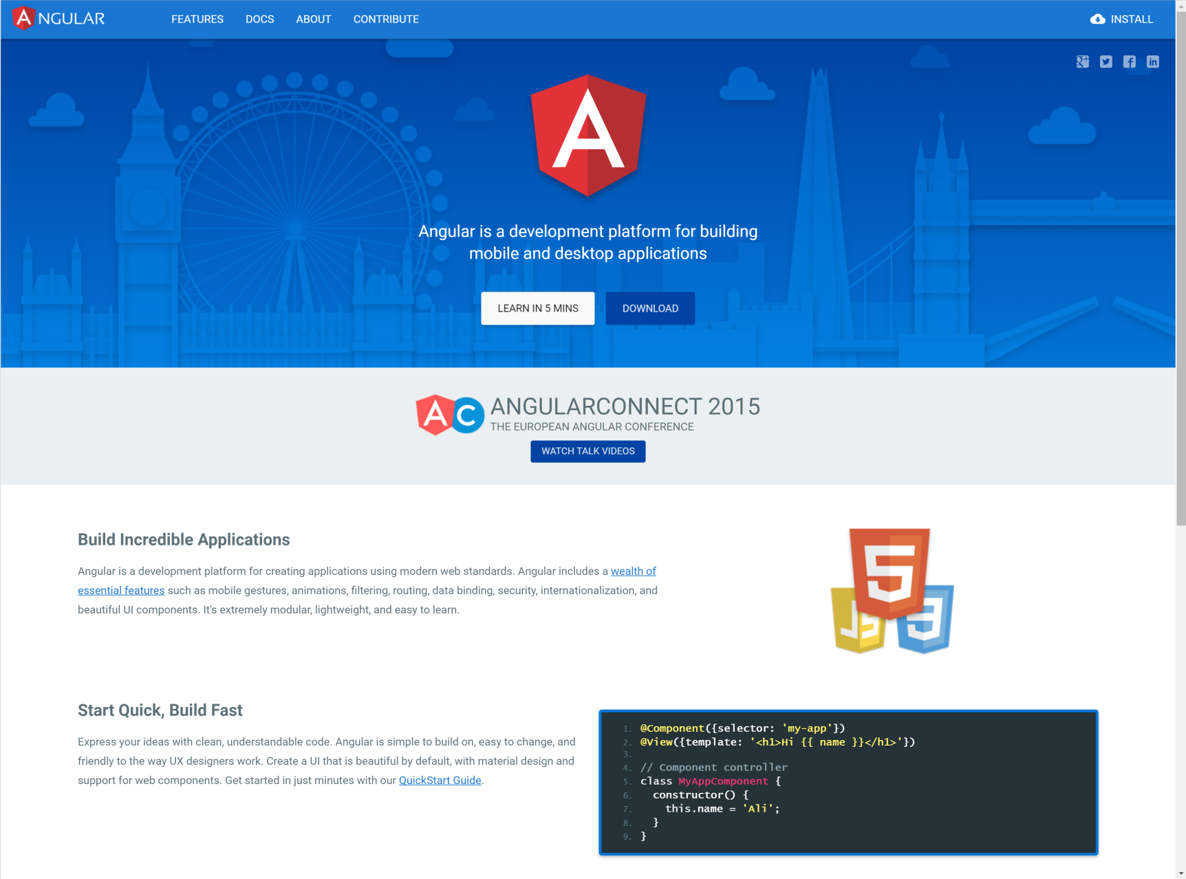

Slide 30

Tweet your favourite feature
@DuncHunter
Notes:
Angular 2 is going to bring a lot of change and I am very excited to start using this in our applications.
If you have started learning Angular 2 I know is a good time to start and we would like to help you stay uptodate.

Slide 31
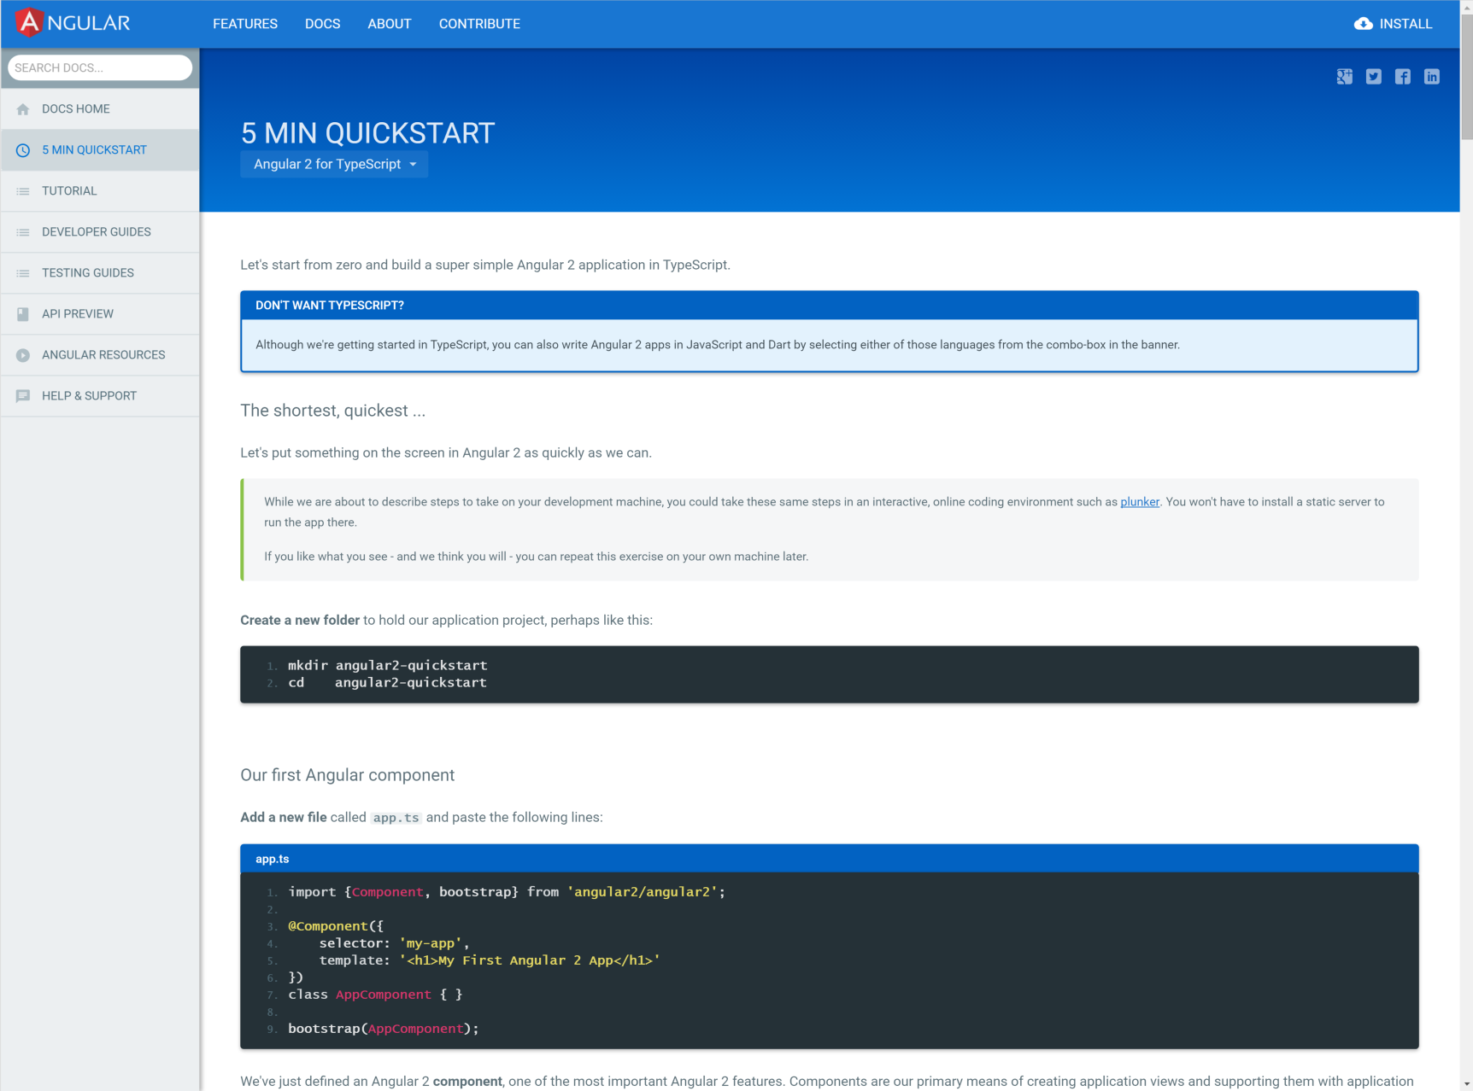

Slide 32
Code Demo
Join the Conversation #AngularSuperPowersTour @AdamStephensen @DuncHunter

Slide 33
Thank you! info@ssw.com.au www.ssw.com.au Sydney | Melbourne | Brisbane | Adelaide
Tweet your favourite part
@AdamStephensen
@DuncHunter
Notes:
Thanks for listenting, and please drop me a tweet with your feedback

Slide 34
https://www.youtube.com/watch?v=Lu2NImUymb4

Slide 35
